Slide 1
QUESTION ANSWERING USING DISTILBERT
GOWTHAMI B GUIDED BY
S2 M.TECH PROF. BINU R
COMPUTATIONAL LINGUISTICS DEPARTMENT OF COMPUTER SCIENCE
GEC PALAKKAD GEC PALAKKAD

Slide 2
PROBLEM STATEMENT
This project aims to explore the capabilities of DistilBERT for Question Answering because it offers the potential to streamline and enhance the process of extracting relevant information ,thereby advancing the development of more efficient and accurate Question Answering systems.

Slide 3
AN INTRODUCTION - QUESTION ANSWERING USING DISTILBERT
01

Slide 4
DISTILBERT
DistilBERT is a distilled version of the BERT (Bidirectional Encoder Representations from Transformers) model, designed for efficient and lightweight natural language understanding tasks.
The DistilBERT Question-Answering System is a natural language processing project that utilizes the DistilBERT model for answering questions based on given context.

Slide 5
BERT
02
BIDIRECTIONAL ENCODER REPRESENTATIONS FROM TRANSFORMERS

Slide 6
BERT
BERT (Bidirectional Encoder Representations from Transformers) is a groundbreaking technique in natural language processing (NLP) that revolutionized how we understand and process language.
BERT is built upon the Transformer architecture, which relies on self-attention mechanisms to process sequences of words. This architecture allows BERT to capture complex relationships and dependencies between words in both directions (bidirectionally).

Slide 7
Bidirectional Context: BERT can capture context from both directions simultaneously. This allows it to generate more accurate representations of words and sentences, leading to better performance on various NLP tasks.
BERT is pre-trained on large corpora of text data using two unsupervised learning objectives:
MASKED LANGUAGE MODEL (MLM)
NEXT SENTENCE PREDICTION (NSP)

Slide 8
MASKED LANGUAGE MODEL (MLM)
BERT randomly masks some of the words in a sentence and trains the model to predict the masked words based on the surrounding context. This helps BERT learn contextual representations of words.
NEXT SENTENCE PREDICTION (NSP)
BERT is also trained to predict whether a sentence follows another sentence in a given text. This helps BERT understand the relationship between sentences and improves its ability to perform tasks like text classification and question answering.

Slide 9
After pre-training, BERT can be fine-tuned on specific NLP tasks with labeled data. By fine-tuning, BERT adapts its pre-learned representations to the specific task, such as sentiment analysis, named entity recognition, or machine translation. Fine-tuning BERT on task-specific data significantly boosts its performance on those tasks.
BERT has inspired various model architectures and pre-training strategies, including:
RoBERTa
DistilBERT
ALBERT

Slide 10
DISTILBERT detailed information
03

Slide 11
DistilBERT, short for "Distilled BERT," is a cutting-edge model in the field of natural language processing (NLP) that represents a smaller, faster version of the highly successful BERT (Bidirectional Encoder Representations from Transformers) model.
This reduction in size and complexity makes DistilBERT particularly suitable for deployment in resource-constrained environments, such as mobile devices and edge devices.
of natural language) model.

Slide 12
DistilBERT is trained using the same pre-training objectives as BERT, including masked language modeling (MLM) and next sentence prediction (NSP).
DistilBERT employs knowledge distillation techniques to transfer knowledge from a larger teacher model (BERT) to a smaller student model (DistilBERT). This process involves distilling the knowledge learned by BERT into a more compact representation that retains most of BERT's performance while requiring fewer parameters

Slide 13
KEY FEATURES OF DISTILBERT
Smaller Size: One of the main features of DistilBERT is its reduced size compared to the original BERT model. By distilling the knowledge from BERT into a smaller architecture, DistilBERT requires fewer parameters, making it more lightweight and easier to deploy on resource-constrained devices.
Faster Inference: Due to its smaller size and optimized architecture, DistilBERT offers faster inference times compared to BERT. This means that it can process input data and generate outputs more quickly .
Comparable Performance: DistilBERT maintains competitive performance on various natural language processing tasks, including question answering, text classification, and language understanding.

Slide 14
LITERATURE SURVEY
04

Slide 15
Paper 1:
DistilBERT, a distilled version of BERT: smaller,faster, cheaper and lighter
Authors : Victor SANH, Lysandre DEBUT, Julien CHAUMOND, Thomas WOLF
Key points :
This paper gives an introduction to the distilbert model .
The paper shows that a general-purpose language model can be successfully trained with distillation and analyzed the various components

Slide 16
Paper 2 :
Comparative Analyses of BERT, RoBERT ,DistilBERT, and XLNet for Text-based Emotion Recognition .
Authors: Henry Nunoo-Mensah , Chen Wenyu, Francisca Adoma Acheampong
Key points:
This paper set out to assess the efficiency of the BERT, RoBERTa, DistilBERT, and XLNet pre-trained transformer models in recognizing emotions from the ISEAR dataset.
The models proved efficient in detecting emotions from the text.

Slide 17
05 RELEVANCE

Slide 18
>The relevance of this project lies in its potential to advance the field of natural language processing (NLP) by harnessing the capabilities of DistilBERT for Question Answering tasks.
>By developing an efficient and accurate Question Answering system, this project addresses the growing demand for AI-powered solutions that can extract relevant information from large volumes of text, benefiting fields such as customer support, education, and information retrieval.
> Additionally, the project contributes to the ongoing research and development efforts aimed at improving language understanding models and enhancing their real-world applications.

Slide 19
FLOW CHART
START
DATA COLLECTION
DATA PRE-PROCESSING
DISTILBERT MODEL
TRAINING
QUESTION ANSWERING SYSTEM
EVALUTION
FINE -TUNING

Slide 20
MODULES
06

Slide 21
DATA COLLECTION
Data collection for the system involves gathering diverse passages along with their associated questions and answers, primarily utilizing SQuAD. These passages, sourced from various mediums, ensure comprehensive coverage across topics.
Through careful annotation, questions are aligned with accurate answers, maintaining dataset reliability. SQuAD's structured approach aids in effective model training and evaluation, driving progress in question answering research.

Slide 22
DATA PRE-PROCESSING
>Data pre-processing is acrucial step in preparing raw data for analysis or model training.
>Tokenization is performed to break down text into smaller units called tokens, facilitating subsequent analysis tasks.

Slide 23
TRAINING PHASE
Initially, the DistilBERT model is trained on a large dataset containing pairs of questions and their corresponding answers.
During training, the model learns to understand the context of the text and how to generate appropriate responses to questions based on this understanding. This process involves adjusting the model's internal parameters to minimize errors and improve performance.

Slide 24
FINE-TUNING
After pre-training, the DistilBERT model is fine-tuned specifically for the task of Question Answering.
This involves further adjusting the model's parameters using a smaller dataset containing examples of questions and their correct answers.
Fine-tuning allows the model to specialize in answering questions more accurately.

Slide 25
INFERENCE PHASE and EVALUATION
> Once the model is trained and fine-tuned, it can be used to answer questions in real-time. During the inference phase, the model takes input in the form of a question and a passage of text relevant to the question. It then processes this input using its learned knowledge to generate a concise and accurate answer.
> Finally, the performance of the DistilBERT-based Question Answering system is evaluated.

Slide 26
RESULT The effectiveness of utilizing DistilBERT for question answering tasks, showcasing its ability to accurately extract relevant information from textual data. Through its streamlined architecture and efficient processing capabilities, DistilBERT proves to be a valuable asset in enhancing the performance and efficiency of question answering systems.

Slide 27
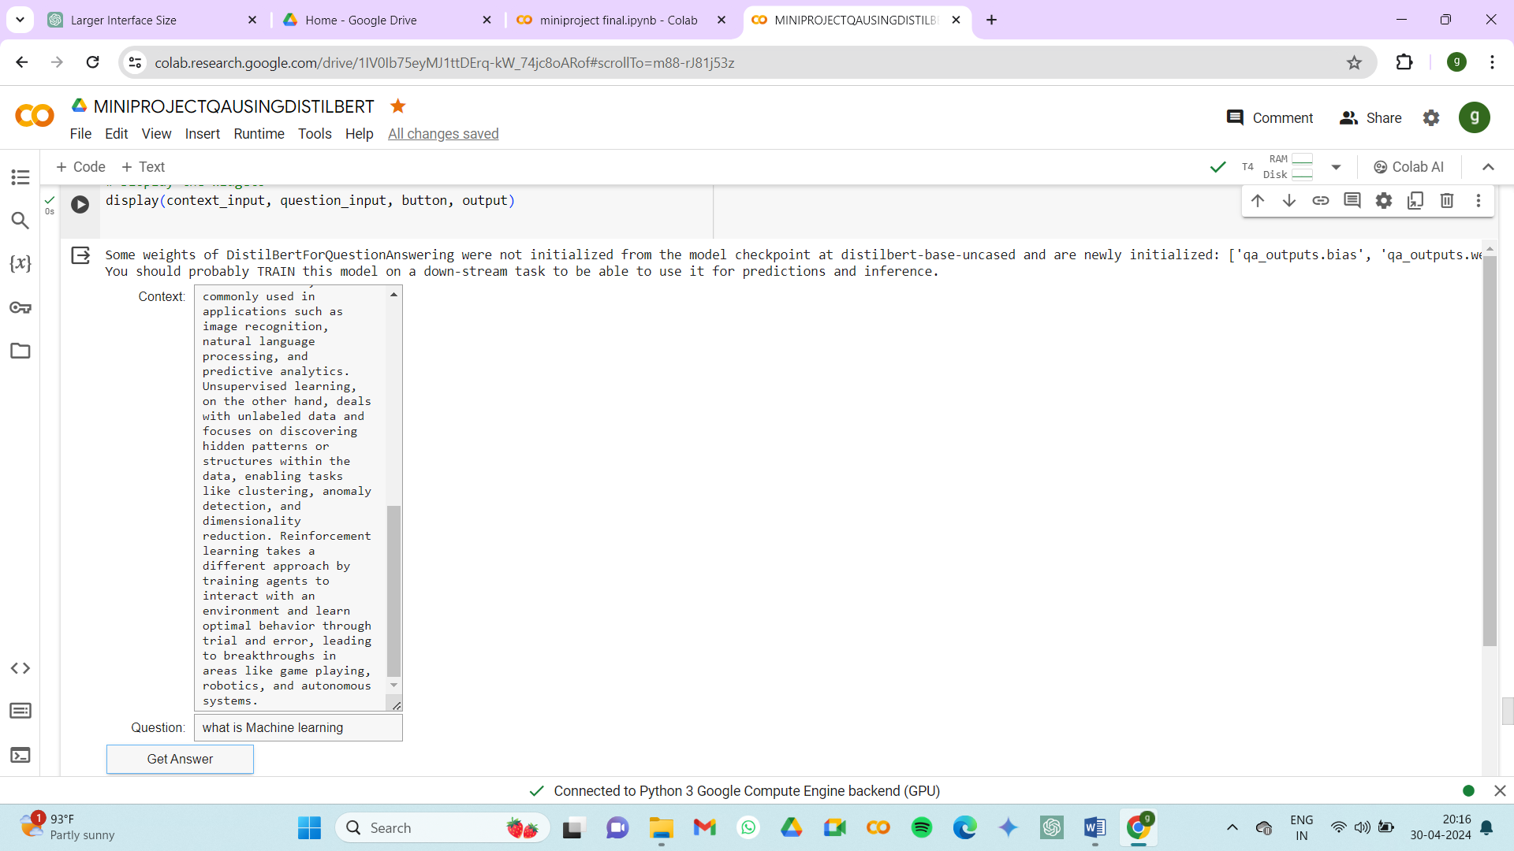
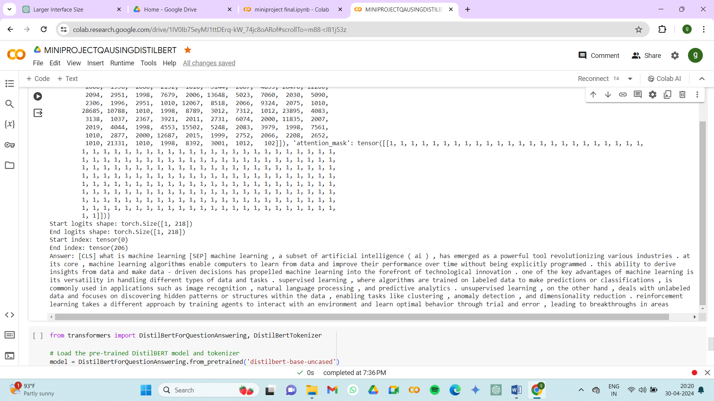

Slide 28
FUTURE WORK
In future work, aim to explore the use of PDF documents as a valuable source of information for question answering tasks. One avenue for exploration is to invest in robust PDF parsing and text extraction techniques to accurately extract relevant information from PDF documents.

Slide 29
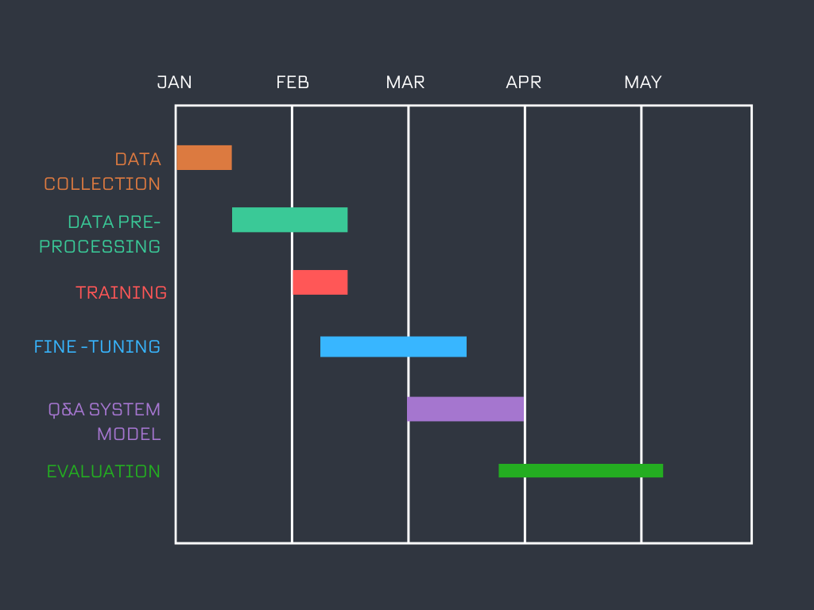
GANTT CHART

Slide 30
CONCLUSION
>It becomes evident that leveraging DistilBERT for question answering tasks yields promising results, demonstrating its efficacy in extracting precise answers from textual data.
>The streamlined architecture and efficient processing capabilities of DistilBERT have significantly enhanced the performance and efficiency of the question answering system, showcasing its potential for real-world applications.
>Moving forward, continued exploration and refinement of DistilBERT-based models hold great promise for advancing the field of natural language processing and improving the accessibility and accuracy of question answering systems.

Slide 31
REFERENCES
>"DistilBERT: A Distilled Version of BERT: Smaller, Faster, Cheaper, and Lighter" by Victor Sanh, Lysandre Debut, Julien Chaumond, and Thomas Wolf
>"Comparative Analyses of BERT, RoBERTa, DistilBERT, and XLNet for Text-based Emotion Recognition" by Henry Nunoo-Mensah, Chen Wenyu, and Francisca Adoma Acheampong
>QuesBELM: A BERT based Ensemble Language Model for Natural Questions .by Raj Ratn Pranesh;Ambesh Shekhar;Smita Pallavi
>A BERT-based Approach with Relation-aware Attention for Knowledge Base Question Answering by Da Luo;Jindian Su;Shanshan Yu
>Analysis of Semantic Comprehension Algorithms of Natural Language Based on Robot’s Questions and Answers by Wendi Li 2020 IEEE International Conference on Advances in Electrical Engineering and Computer Applications( AEECA)
>Comparative Analyses of Bert, Roberta, Distilbert, and Xlnet for Text-Based Emotion Recognition Acheampong Francisca Adoma; Nunoo-Mensah Henry; Wenyu Chen 2020 17th International Computer Conference on Wavelet Active Media Technology and Information Processing (ICCWAMTIP)

Slide 32
THANK YOU

